Slide 1
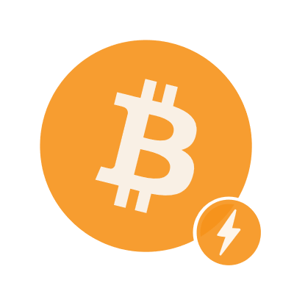
bitcoin
LIGHTNING NETWORK

